Slide 1

Interim Project: Phase 2
Team 1:
Areebah Fatima
Tyler Hargreaves
Darrien Kramer
Ilhaam Syed
Nathan Heindl
Matthew Bedford

Slide 2
System Overview
This project's end goal is to create a system that will provide users with relevant information using the keywords entered by the user. The resulting data provided to the end user will be a sorted and filtered list of web page URLs.
The system allows sponsors to pay to promote their websites to the top of the search result list.
The major components of the search engine will include a search interface, indexing system, result filtering, query processing, etc.
The search interface will allow the end user to interact with the system, enter search queries, and retrieve information.
The indexing system will organize, store, and rank information to allow for a reasonably fast search.
Result filtering will ensure that our system provides users with relevant, up-to-date data in sorted order.
The query processing component of the project will be responsible for interpreting user inputs, identifying keywords in said input, performing index lookup, and retrieving results.

Slide 3
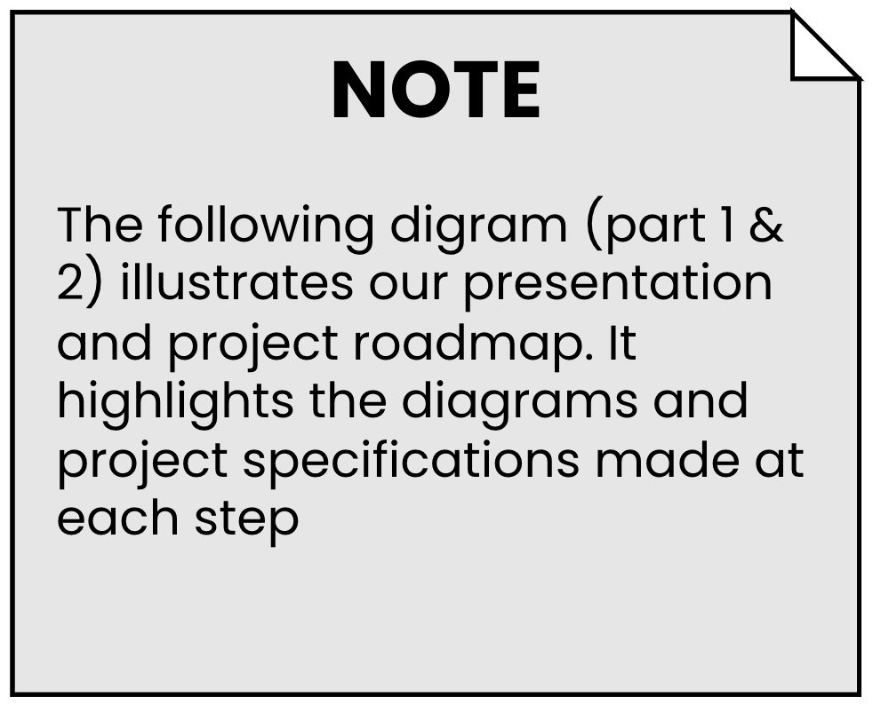
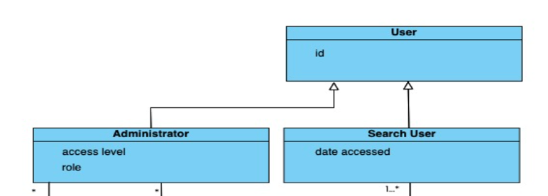
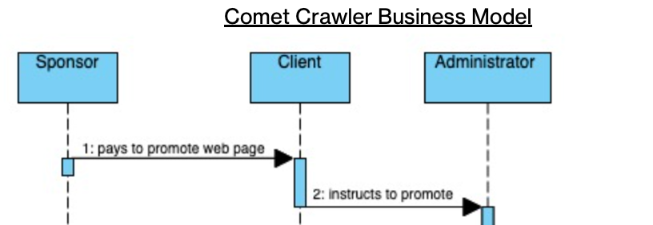
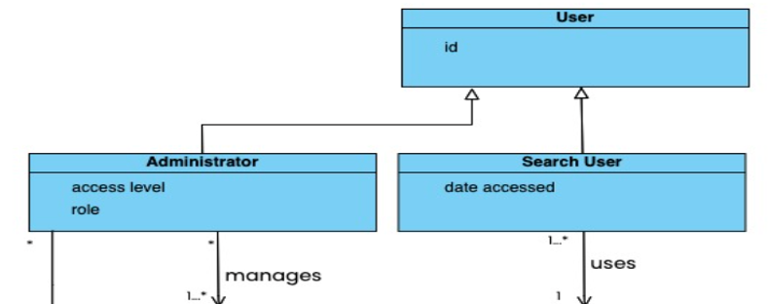
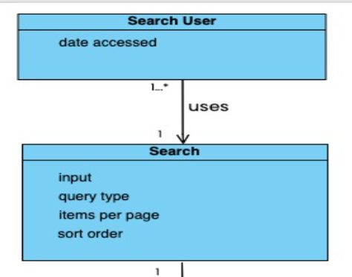
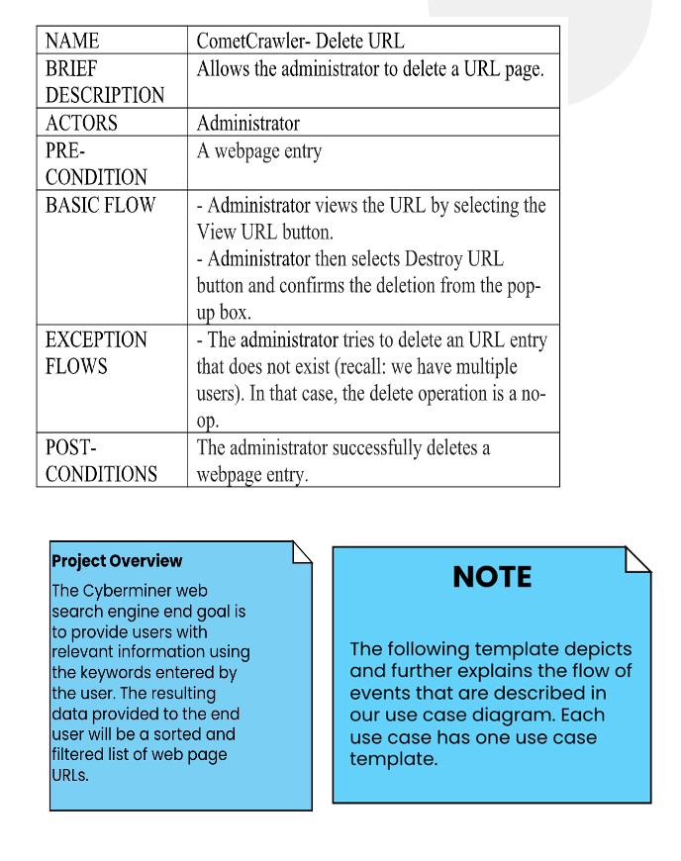
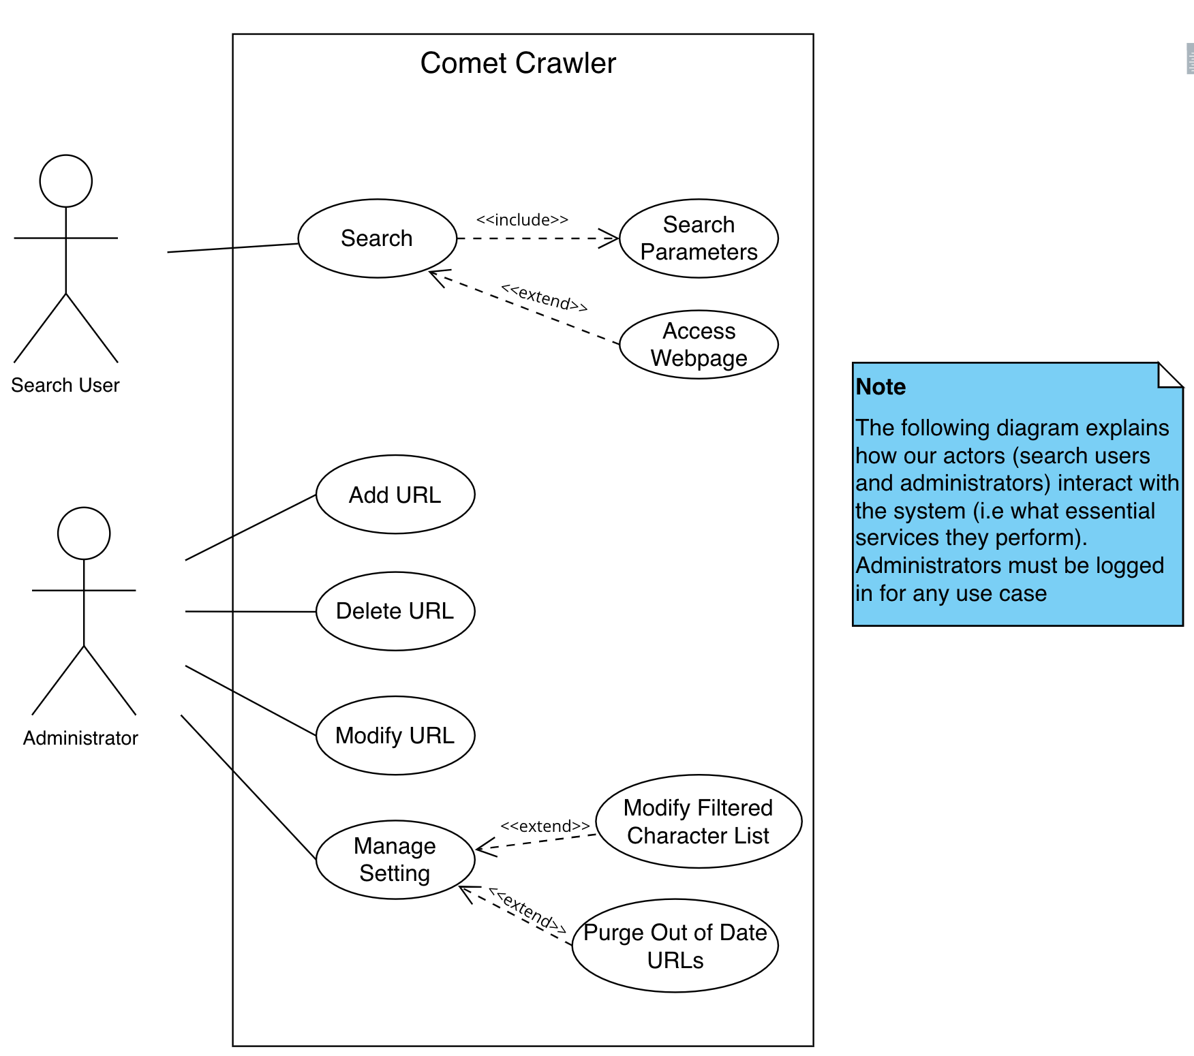
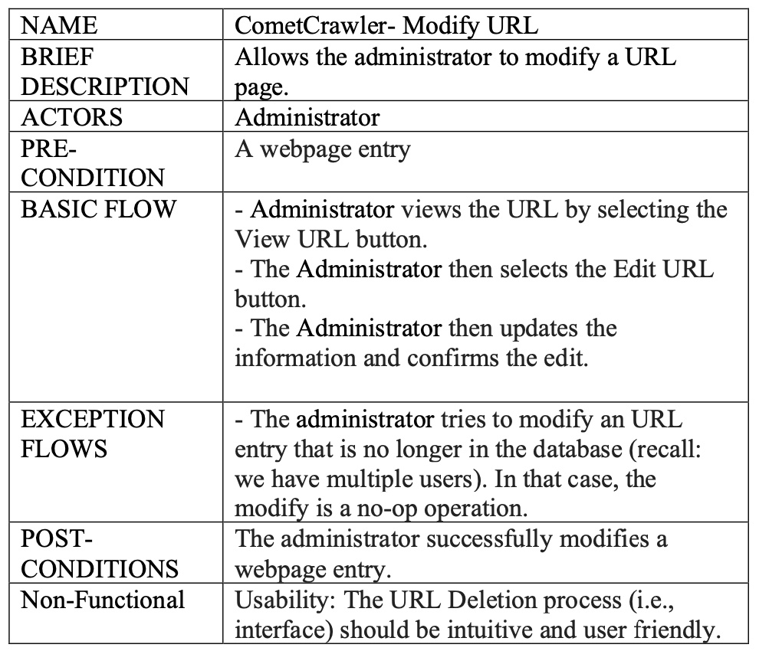

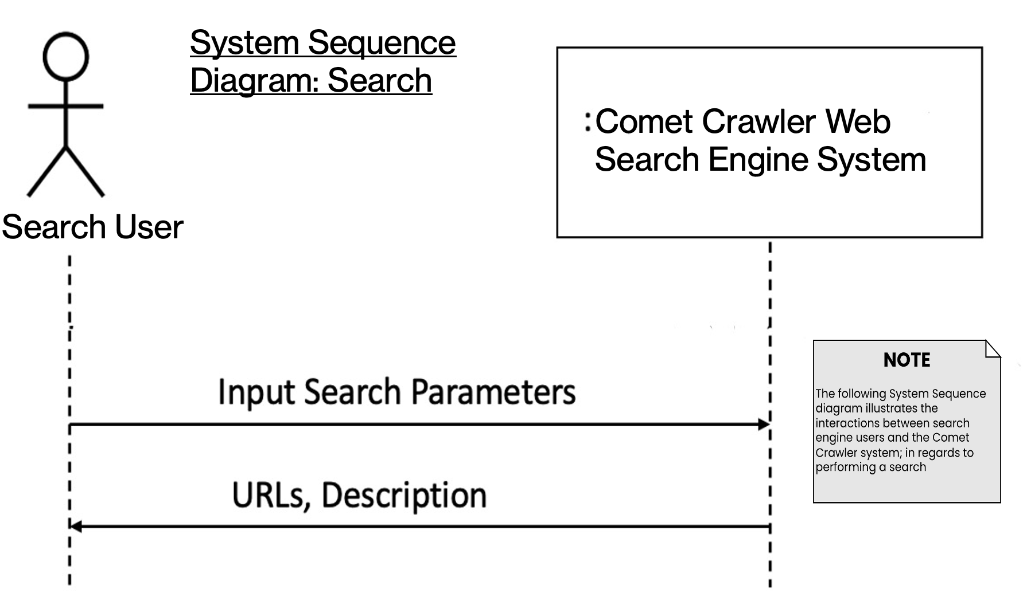
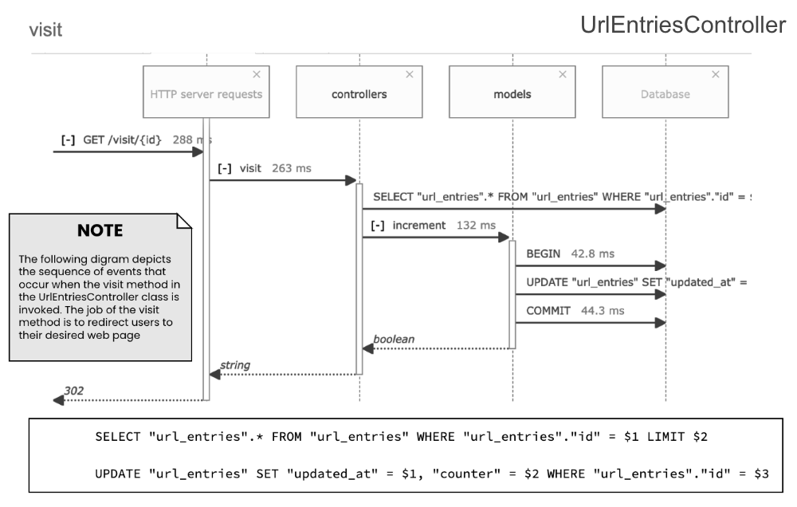
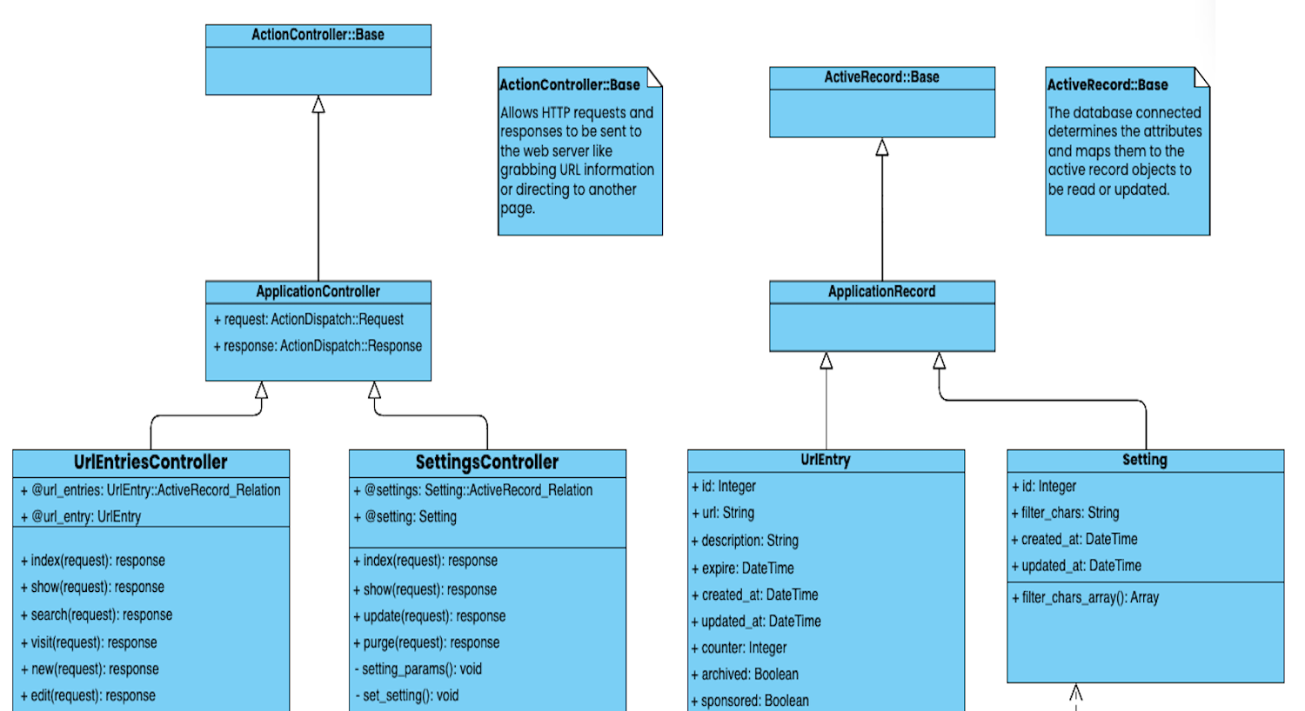
Domain Model
Stakeholder: Client
Stakeholder: Search User
Business Modeling
…
…
…
…
Domain Model Class Diagram
Domain Class Diagram for Stakeholders
Business Model Sequence Diagram
Use-Case Model
Use Case Diagram
Requirements
Final Phase II Project Plan Document
Requirements System Sequence Diagram
Use Case Template
Design
Design Sequence Diagram
Design Class Diagram
Notes:
Add view project details

Slide 4
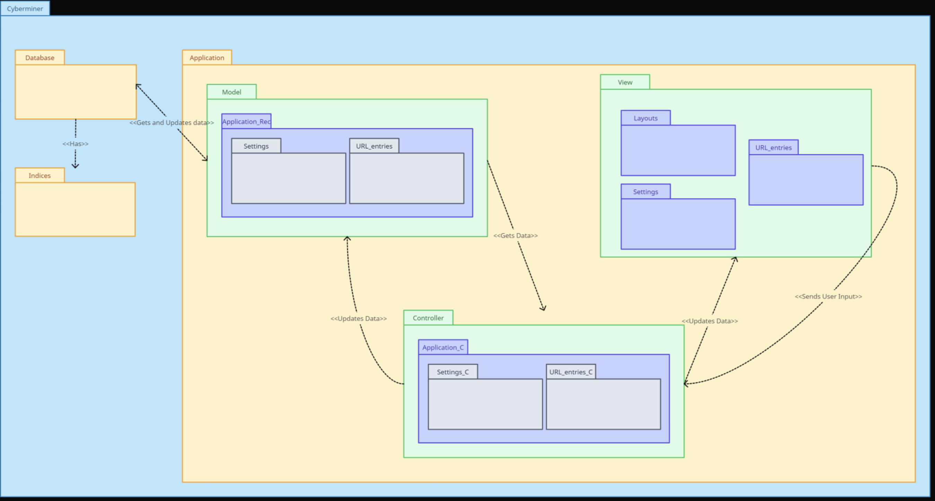
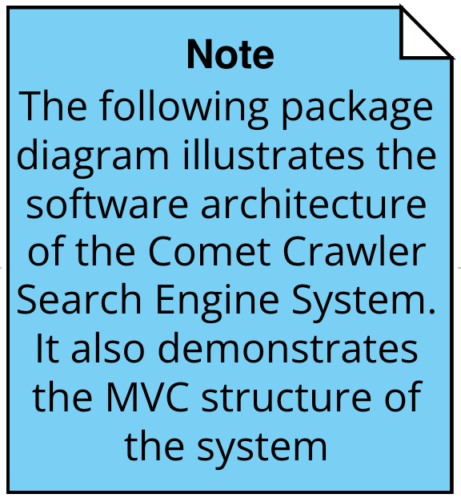
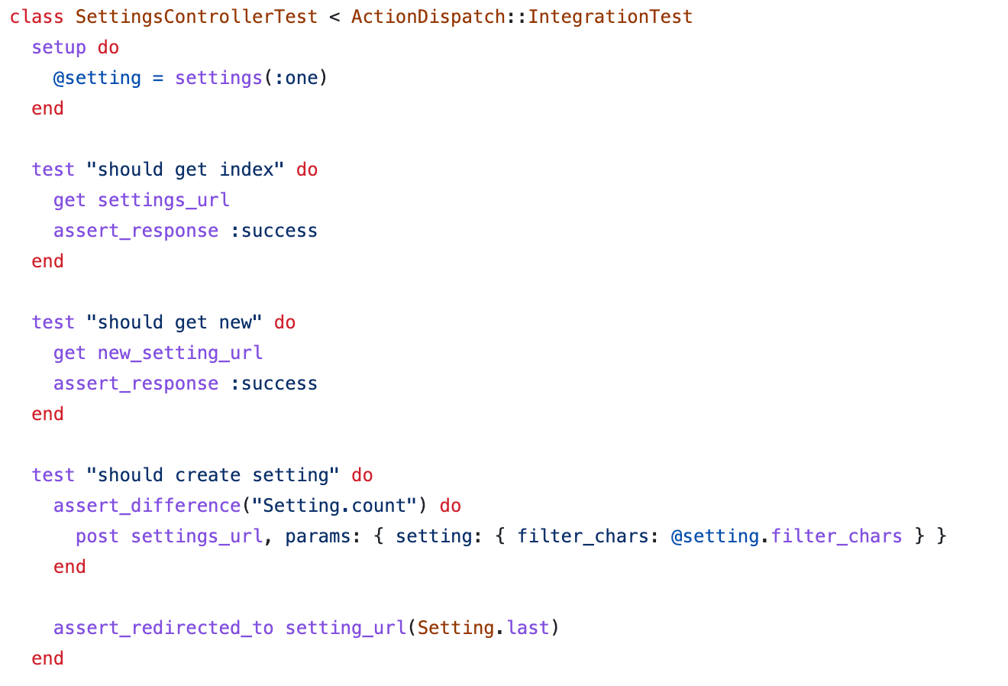
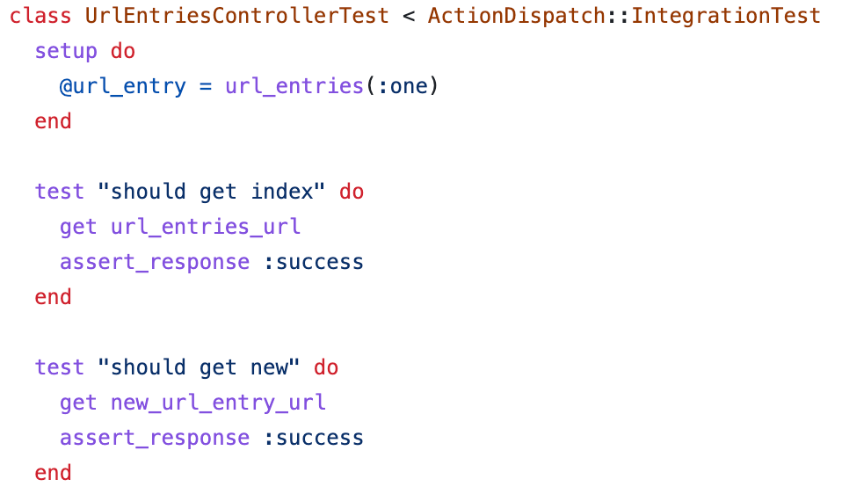
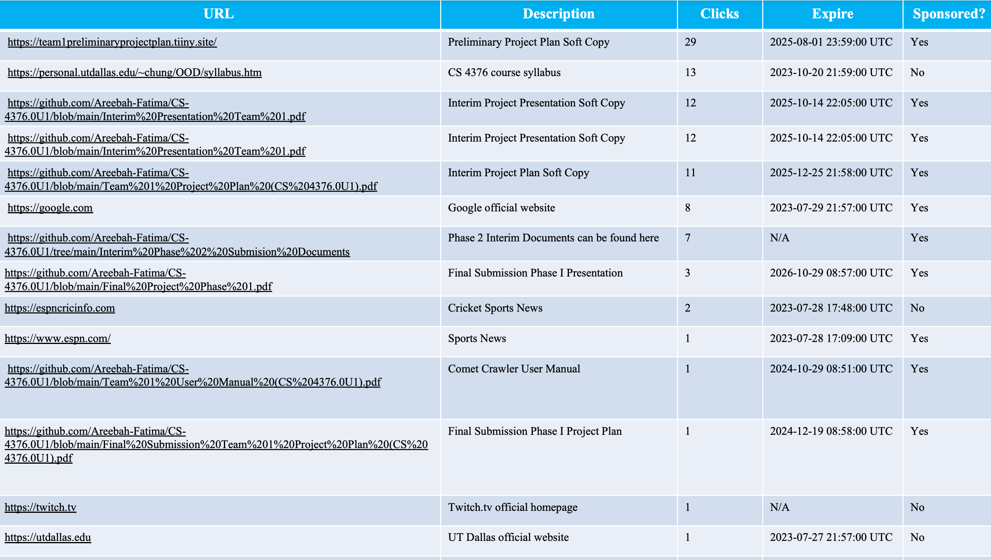
Rails is a Model-View-Controller framework written in Ruby. It is designed to make programming web applications easier by making assumptions about what is “best”.
Example: Rails makes the assumption that you will want CRUD functionality in your HTTP controller, so it includes default functions for these actions that can be extended with specific business logic.
The Rails philosophy includes two major guiding principles:
Don't Repeat Yourself: Every piece of knowledge must have a single, unambiguous, authoritative representation within a system.
Convention Over Configuration: Rails has opinions about the best way to do many things in a web application, and defaults to this set of conventions, rather than require that you specify minutiae through endless configuration files.
Implementation
Language and server-side web application framework
Package Diagram
More Test Cases can be found on our GitHub repository
Testing
Test Case
Indices Listing
Last Updated on 07/29/2023

Slide 5
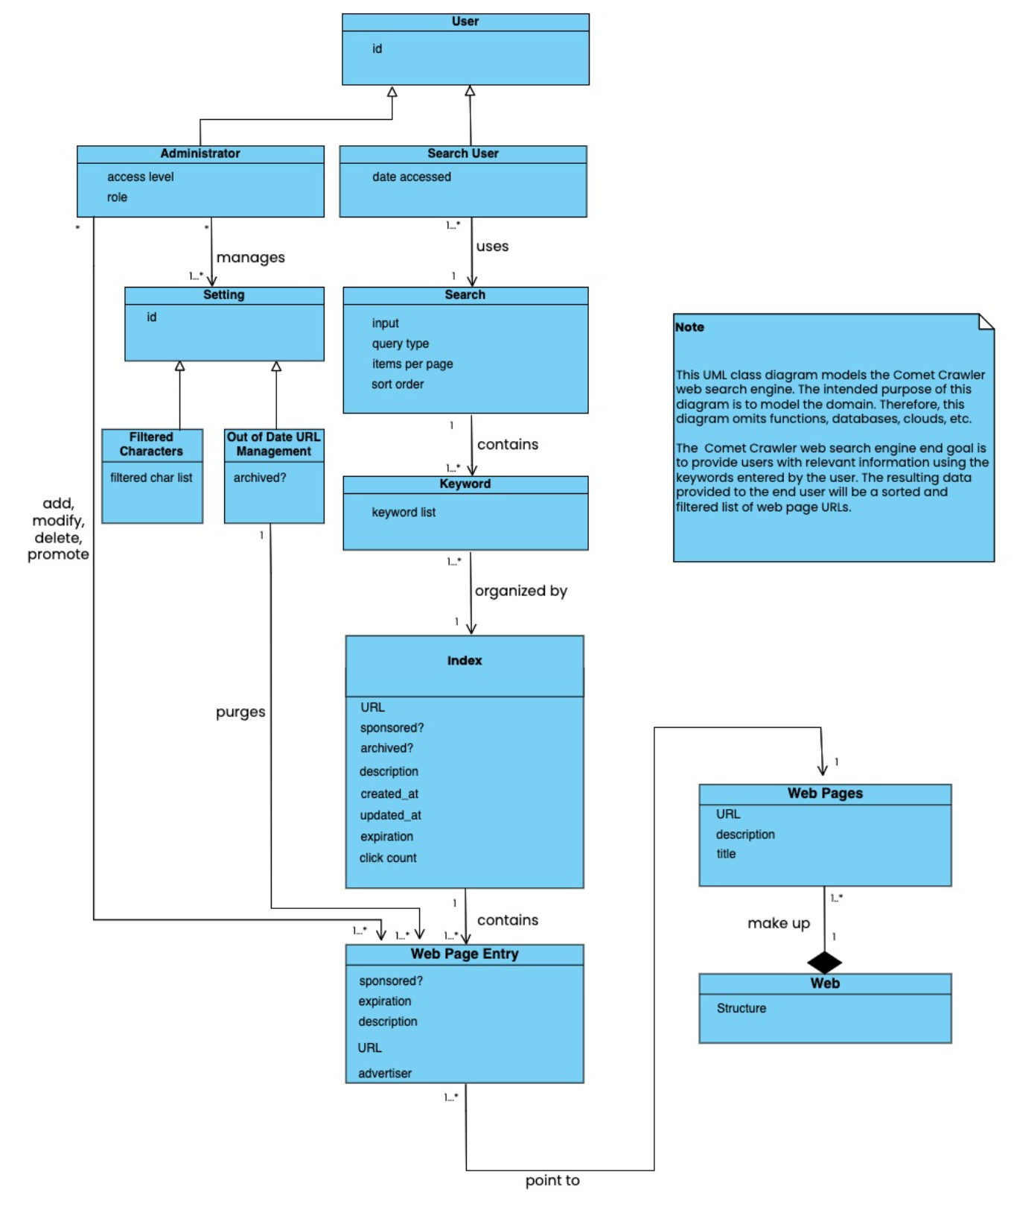
Domain Model Class Diagram
This diagram is a part of Business Modeling

Slide 6
Comet Crawler Stakeholders
Administrator: Are privileged users with the ability to add, delete, and modify URL entries. In addition to this, they also manage the system filtering and purging settings.
Client: Are the ultimate owner of the project. This ownership allows them to specify project requirements, making them the recipients of project deliverables and the resulting product.
Sponsor: Are the individuals that pay money to promote their websites to the top of the search result list. Stakeholders are the central piece of the business model as they bring monetary incentives for clients.
Search Users: Are the individuals who interact with the Comet Crawler System. They will provide the search parameters and view the associated results. Sponsors will target these users.

Slide 7
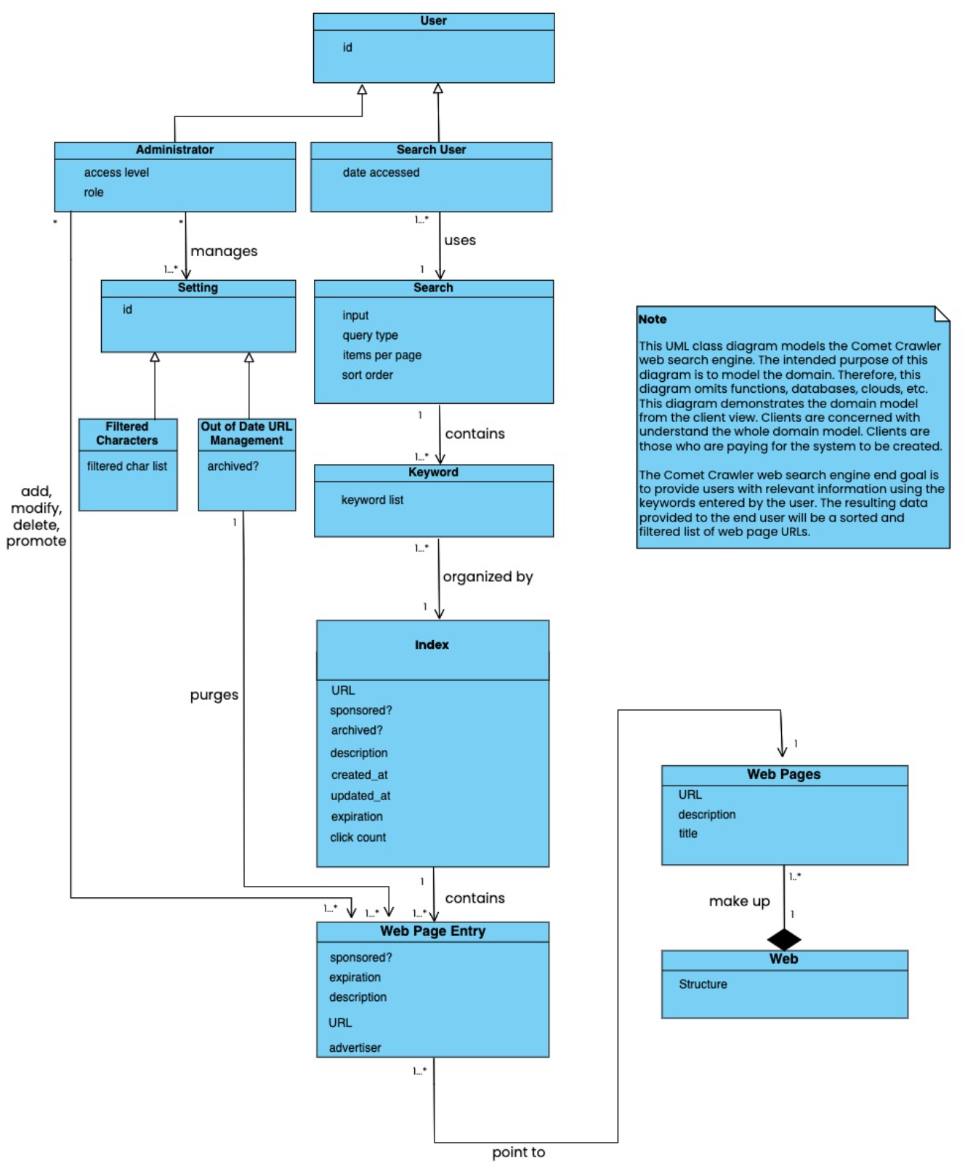
Stakeholder Domain Model Class Diagram: Client
This diagram is a part of Business Modeling

Slide 8
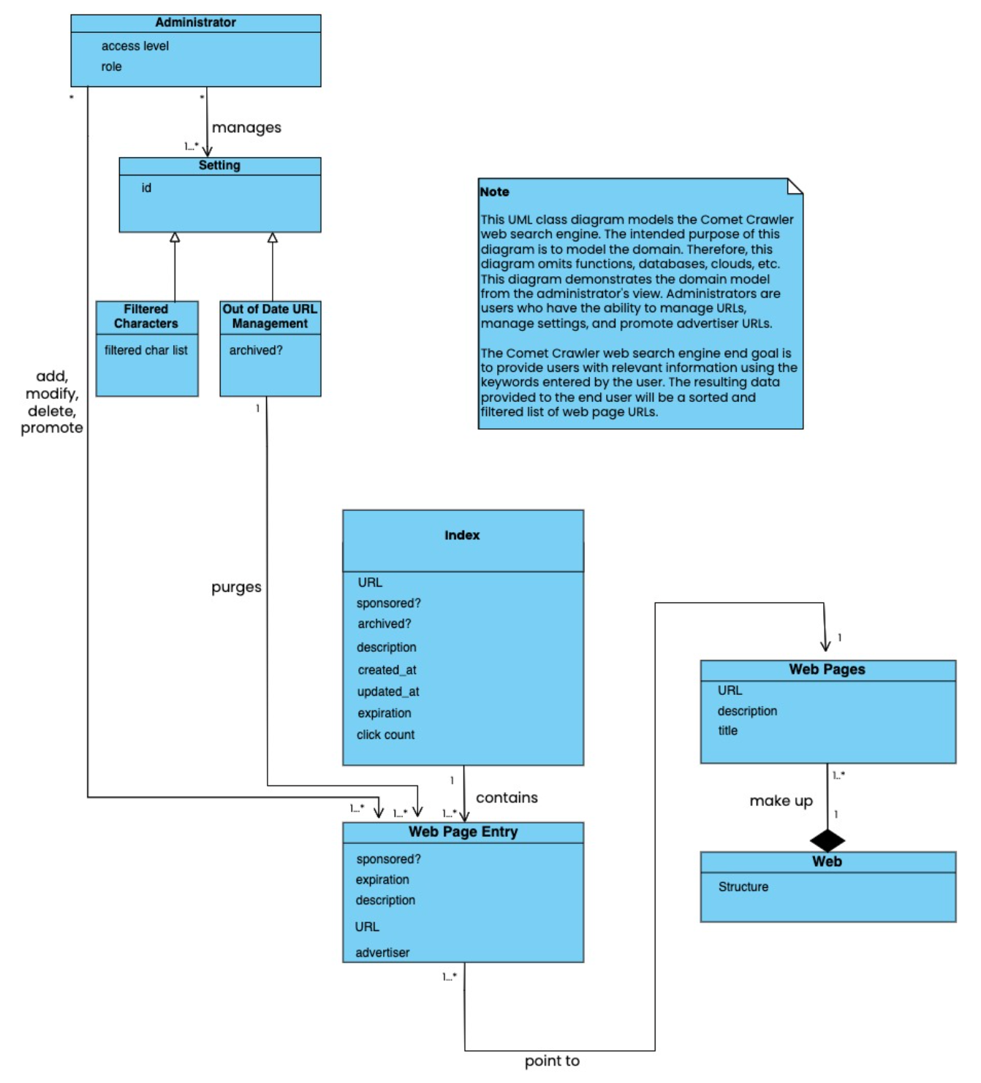
Stakeholder Class Diagram : Administrator
This diagram is a part of Business Modeling

Slide 9
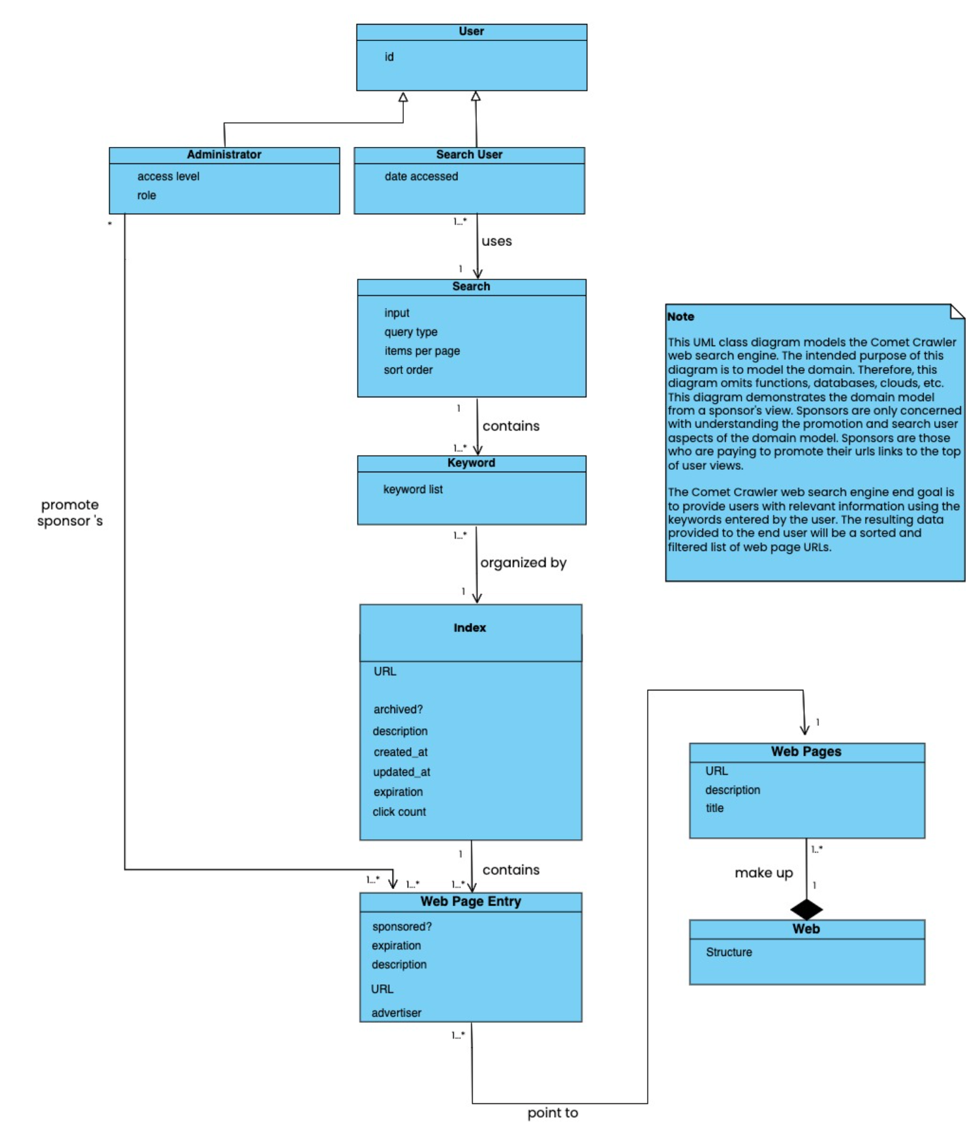
Stakeholder Class Diagram : Sponsor
This diagram is a part of Business Modeling

Slide 10
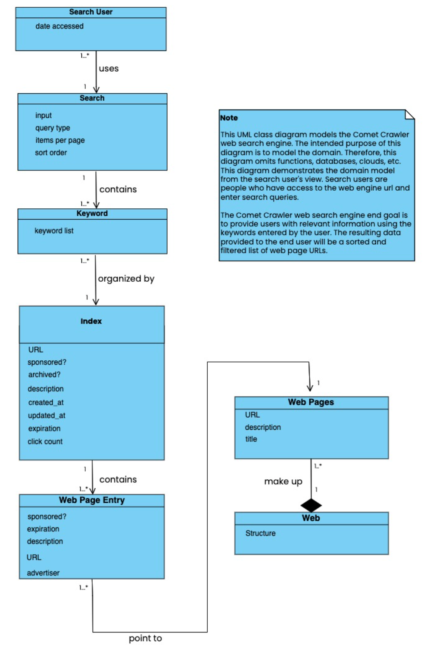
Stakeholder Class Diagram : Search Users
This diagram is a part of Business Modeling

Slide 11
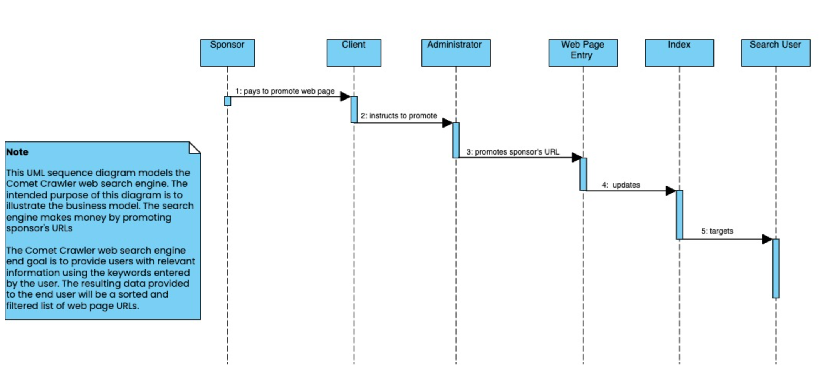
Business Model Sequence Diagram
This diagram is a part of Business Modeling
Comet Crawler Business Model

Slide 12
Functional Requirements
1F. Case-sensitive Search: The system shall strictly store and retrieve the input as provided, preserving case sensitivity.
2F. Hyperlink enforcement: When a user clicks on a URL obtained from a query result, the system shall redirect the user to the corresponding website.
3F. Specifying OR/AND/NOT Search: The system shall allow users to specify the search mode (OR, AND, or NOT) for keyword-based searches.
4F. Multiple search engines: The system shall support the concurrent execution of multiple search engines.
5F. Purging of out-of-date URLs and descriptions: The system shall provide the functionality to delete outdated URLs and their corresponding descriptions from the database.
6F. Query result listing options: The system shall offer the ability to list query results in ascending alphabetical order, most frequently accessed order, or based on payment preferences.
7F. Customizable result display and navigation: The system shall allow users to set the number of results displayed per page and provide navigation functionality between pages.
8F. Autofill with error correction: The system shall automatically provide autofill suggestions while correcting typographical errors.
9F. Symbol filtering based on user configuration: According to user-configured settings, the system shall filter out symbols that are not considered meaningful.
10F. Sponsored Web Entries with Priority Display: The system shall allow web entries to be identified as sponsored if an advertiser has paid for its promotion. Sponsored URLs shall be given priority in the display of query results, ensuring they are shown prominently before non-sponsored entries.
11F. Search Query Result List: The system shall provide users with the ability to input a search query and, upon submission, generate and display a list of URL entries as the output based on the search query.
12F. Parsing and Filtering of User Input Queries: The system shall parse user input queries to extract relevant keywords while ignoring specified filter characters. The extracted keywords shall be utilized to generate the resulting output list of URL entries.
13F. URL Entry Management: The system shall provide specific users with the ability to add, modify, delete, and promote URL entries. These privileged users shall have the necessary access and permissions to perform these actions on the URL entries within the system.

Slide 13
Non-Functional Requirements
1NF. Performance: The Comet Crawler system shall provide fast and efficient search results, ensuring minimal response times (no more than 3 seconds) even when handling many concurrent user requests.
2NF. Compatibility and Portability: The Comet Crawler system shall be compatible with commonly used web browsers, ensuring proper functionality across different browser versions and computer systems.
3NF. Usability: The Comet Crawler system shall have a user-friendly interface, providing users with a seamless and intuitive search experience. It should be accessible across different devices and platforms.
4NF. Error-Handling: The Comet Crawler system shall implement error-handling mechanisms to handle exceptions and provide informative error messages to users.
5NF. Reliability: The Comet Crawler shall be highly reliable, providing users with consistent and uninterrupted search functionality. It should minimize system failures and errors, ensuring reliable access to search capabilities and delivering accurate results.

Slide 14
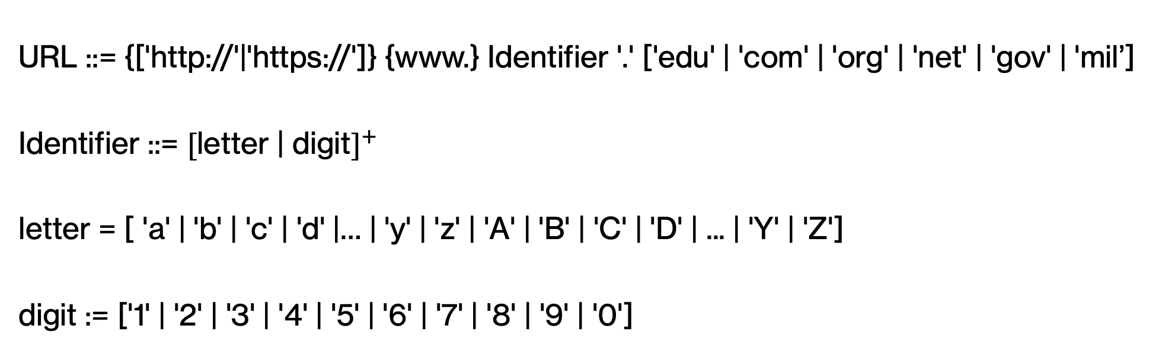
URL Syntax BNF
URL ::= {['http://'|'https://']} {www.} Identifier '.' ['edu' | 'com' | 'org' | 'net' | 'gov' | 'mil’]
Identifier ::= ${\text{[}\text{letter}\text{ | }\text{digit}]}^{+}$
letter = [ 'a' | 'b' | 'c' | 'd' |… | 'y' | 'z' | 'A' | 'B' | 'C' | 'D' | ... | 'Y' | 'Z']
digit := ['1' | '2' | '3' | '4' | '5' | '6' | '7' | '8' | '9' | '0']
This slide is a part of Requirements

Slide 15
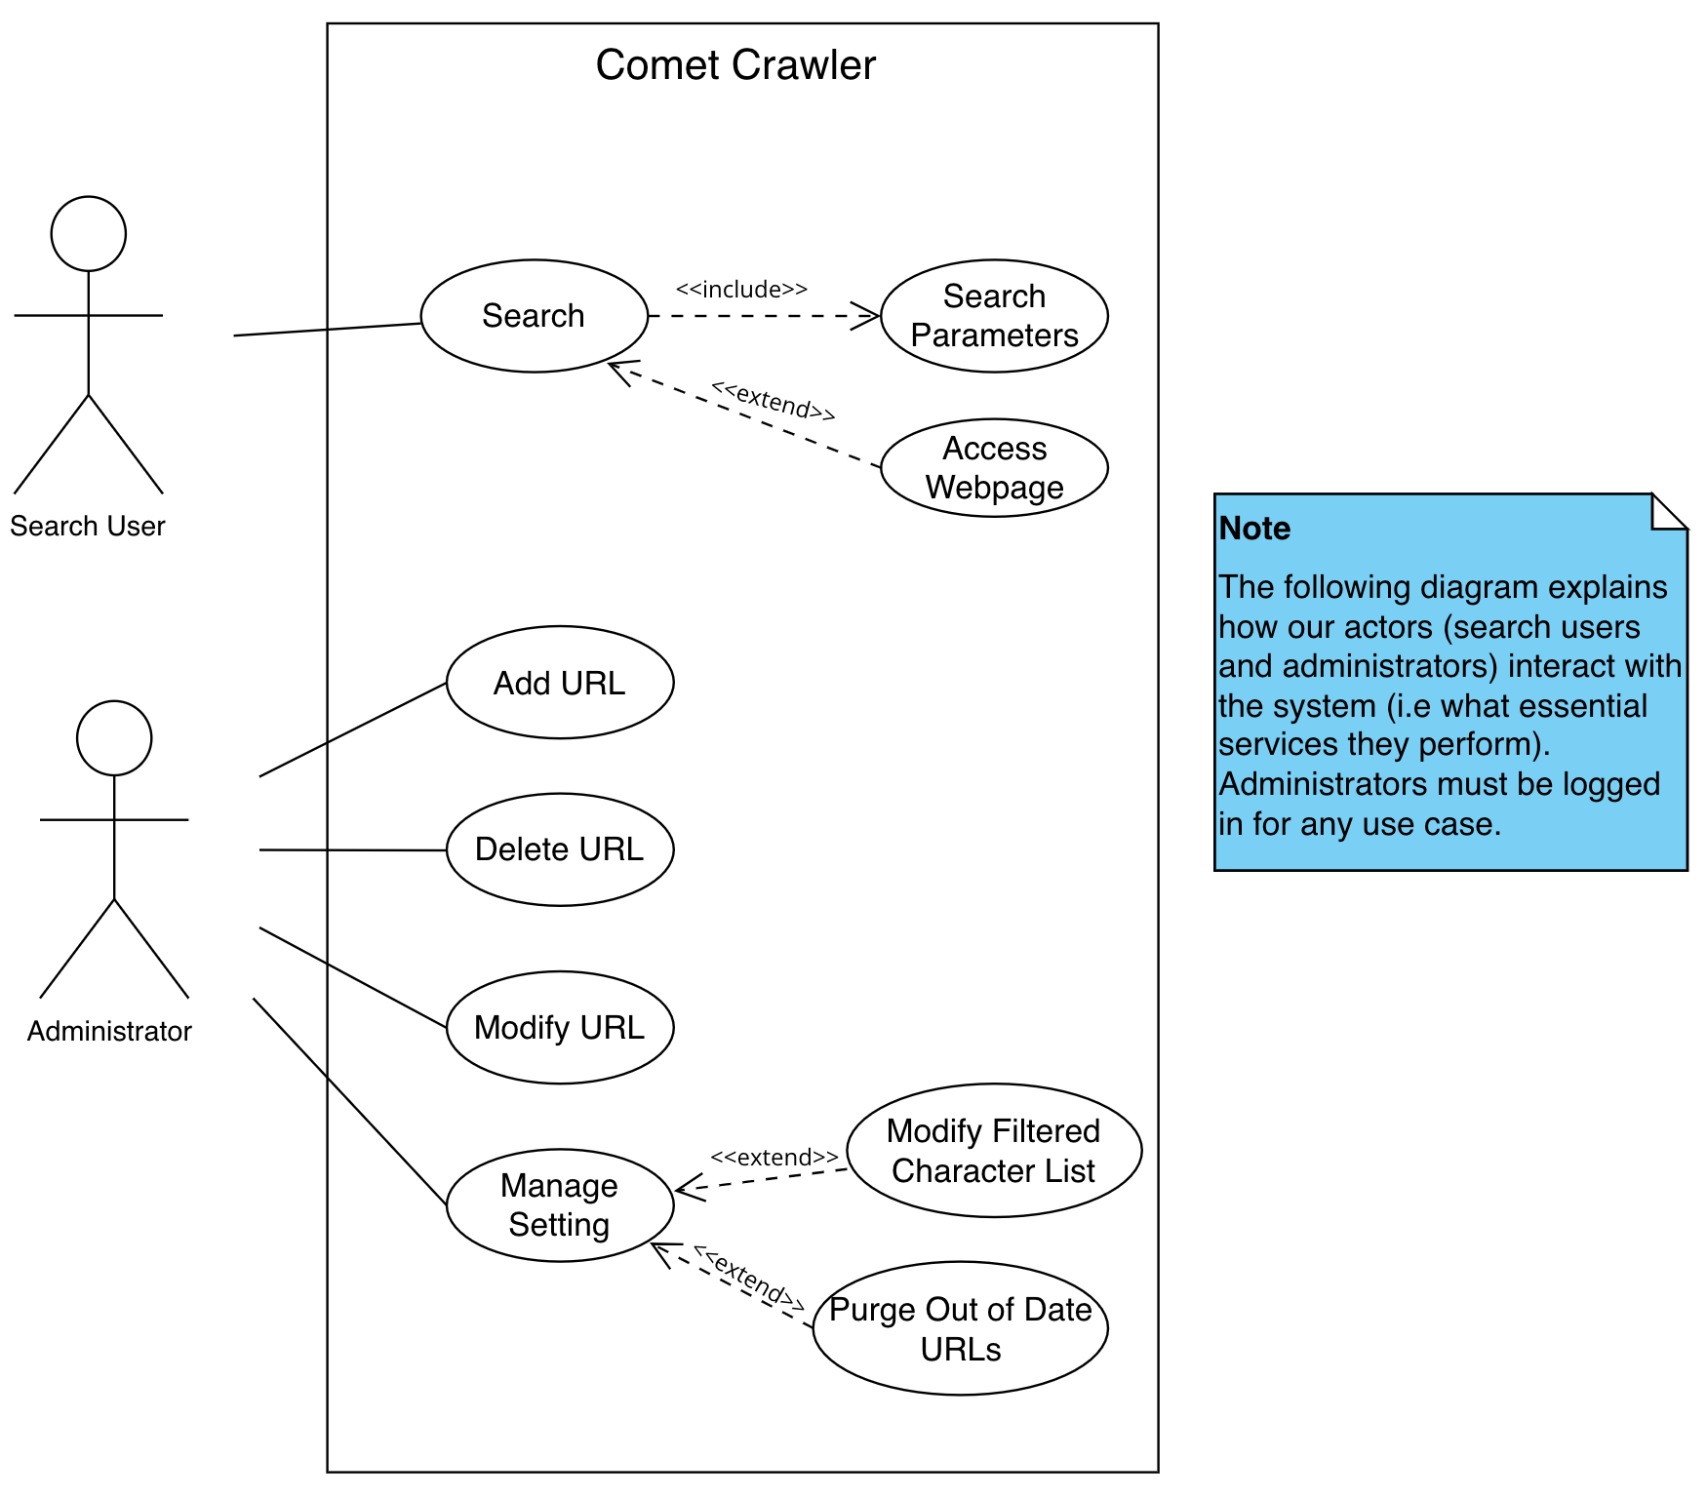
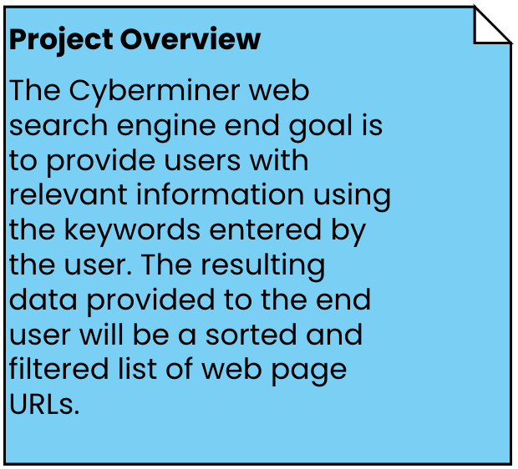
Use Case Diagram
This diagram is a part of Requirements

Slide 16
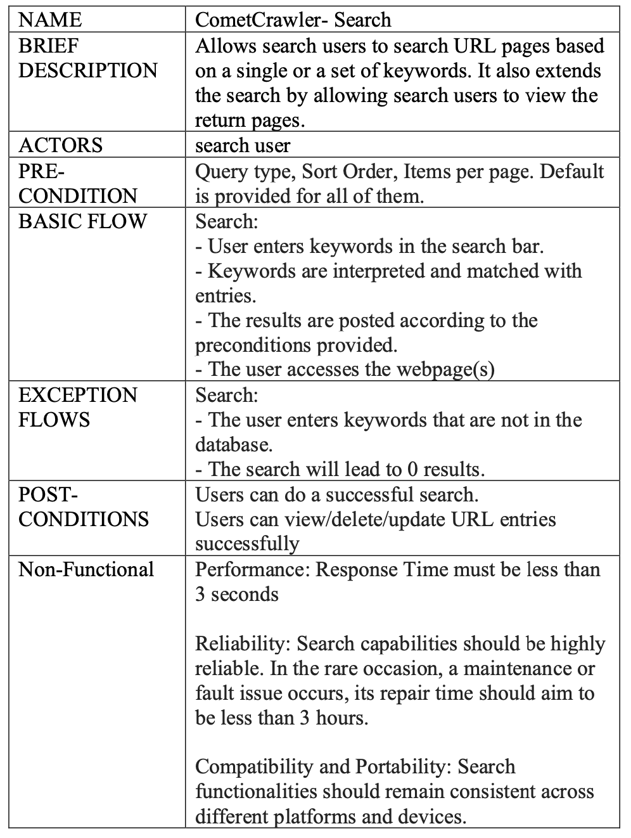
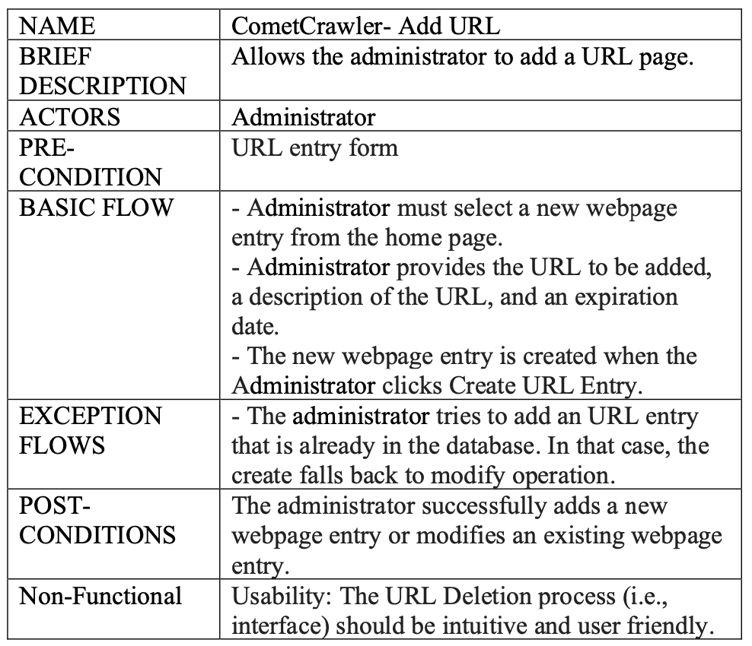
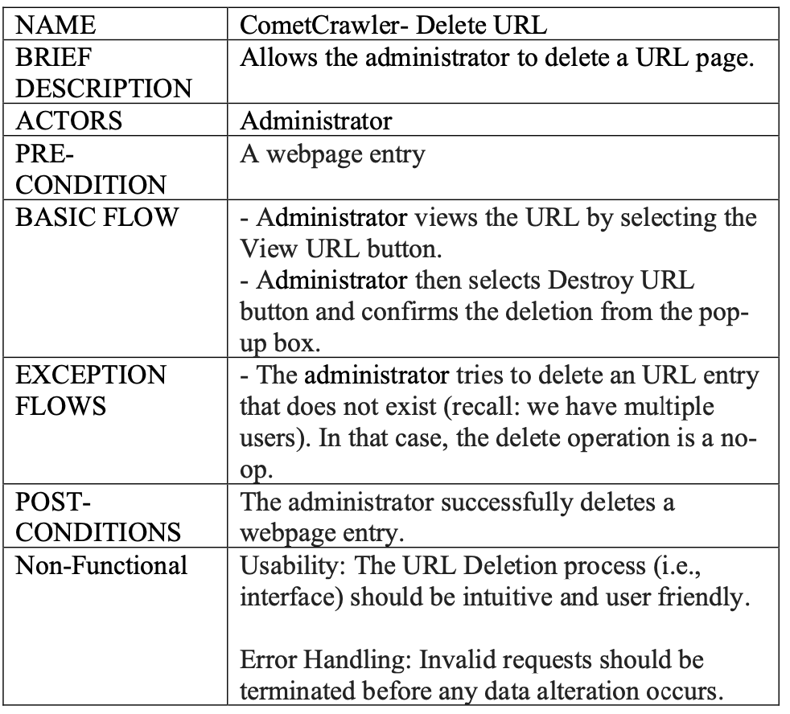
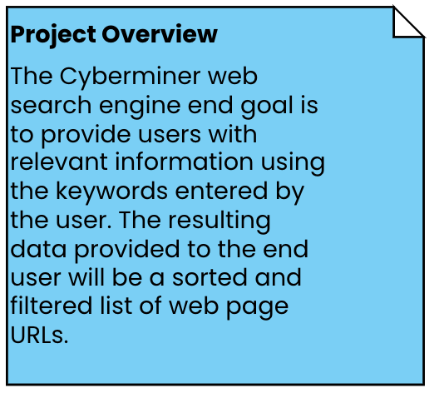
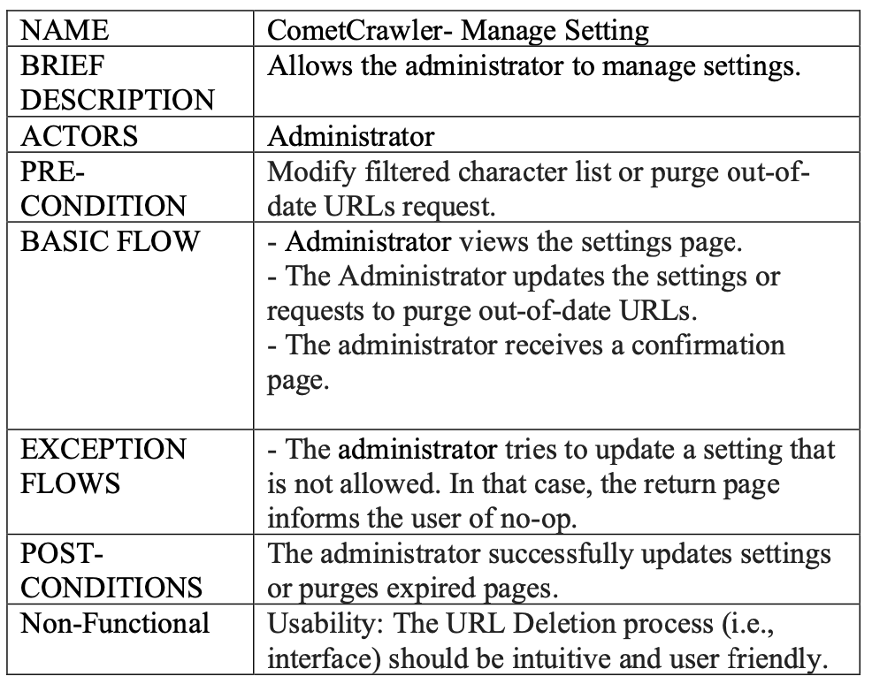
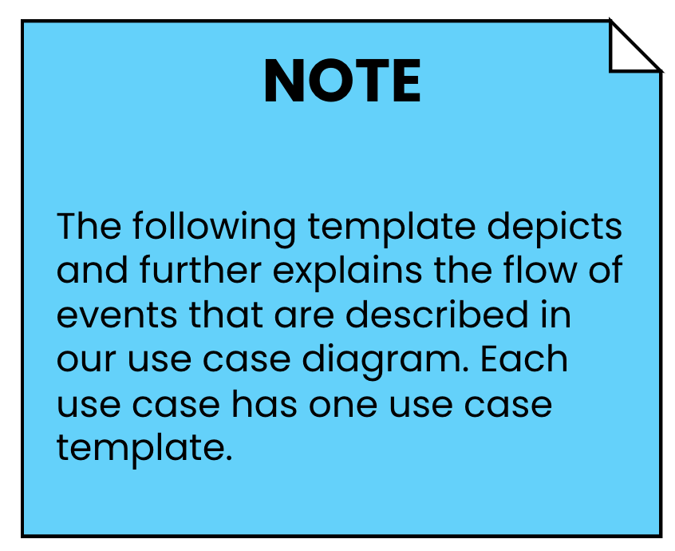
Use Case Template
These diagrams are a part of Requirements

Slide 17
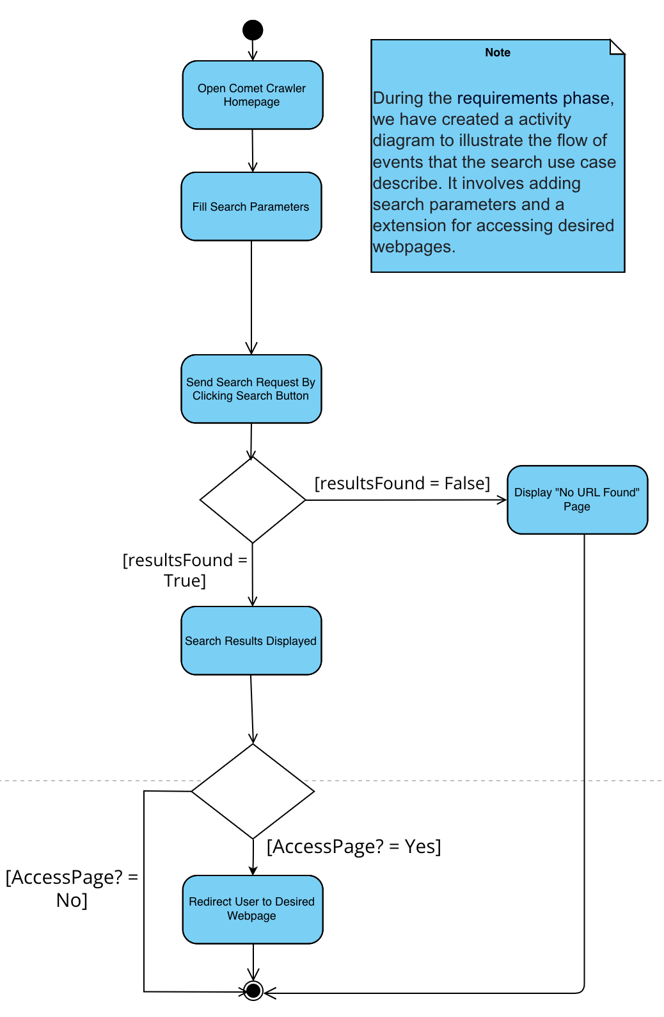
Activity Diagrams
Search Activity Diagram

Slide 18
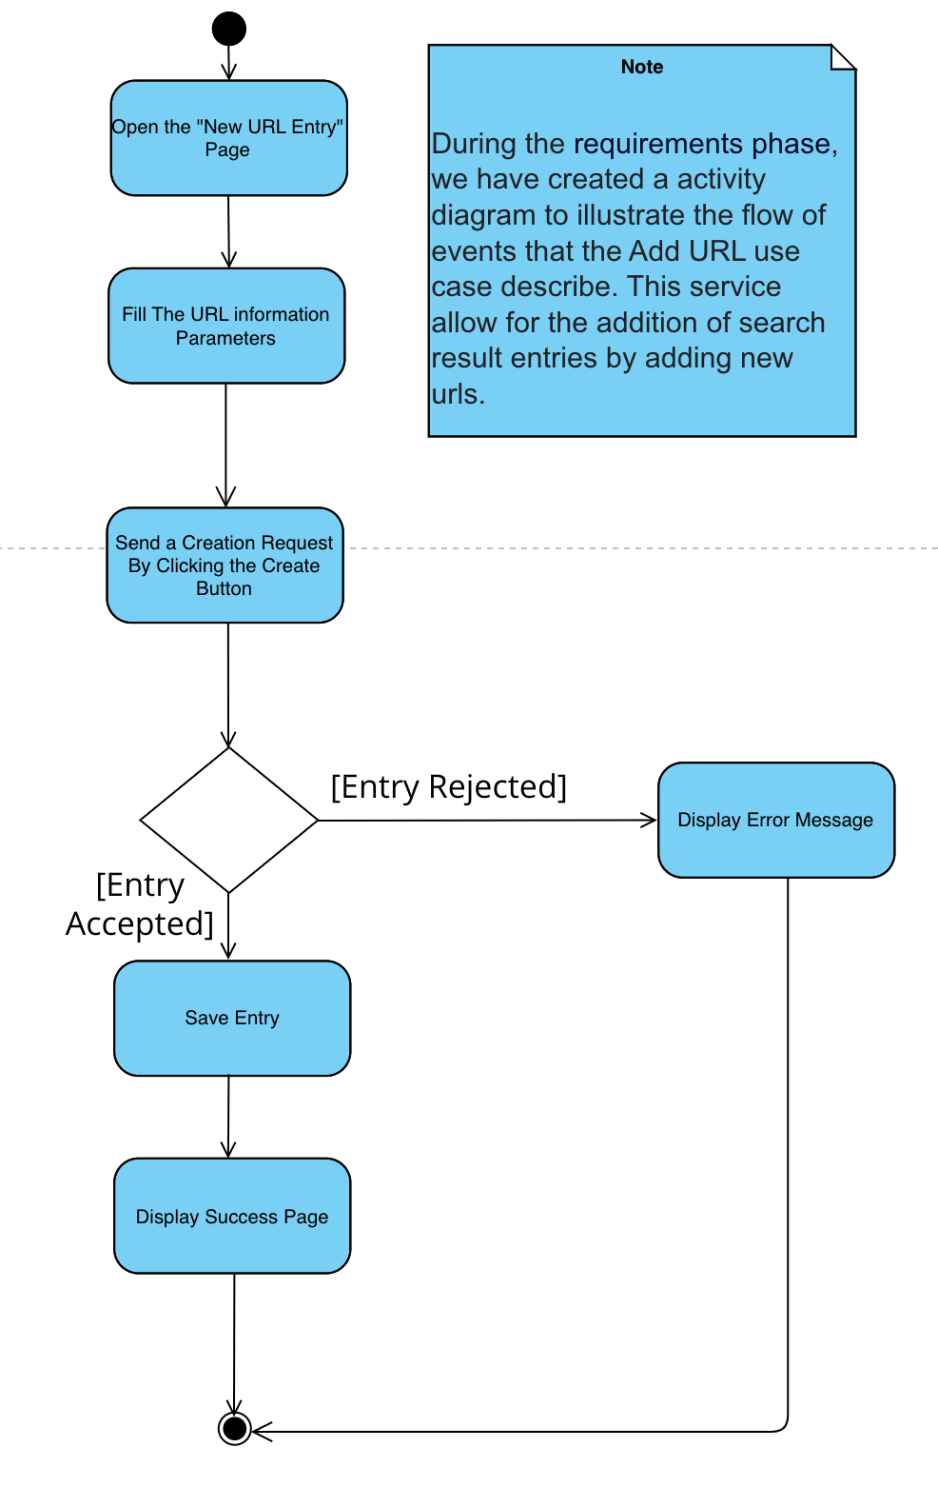
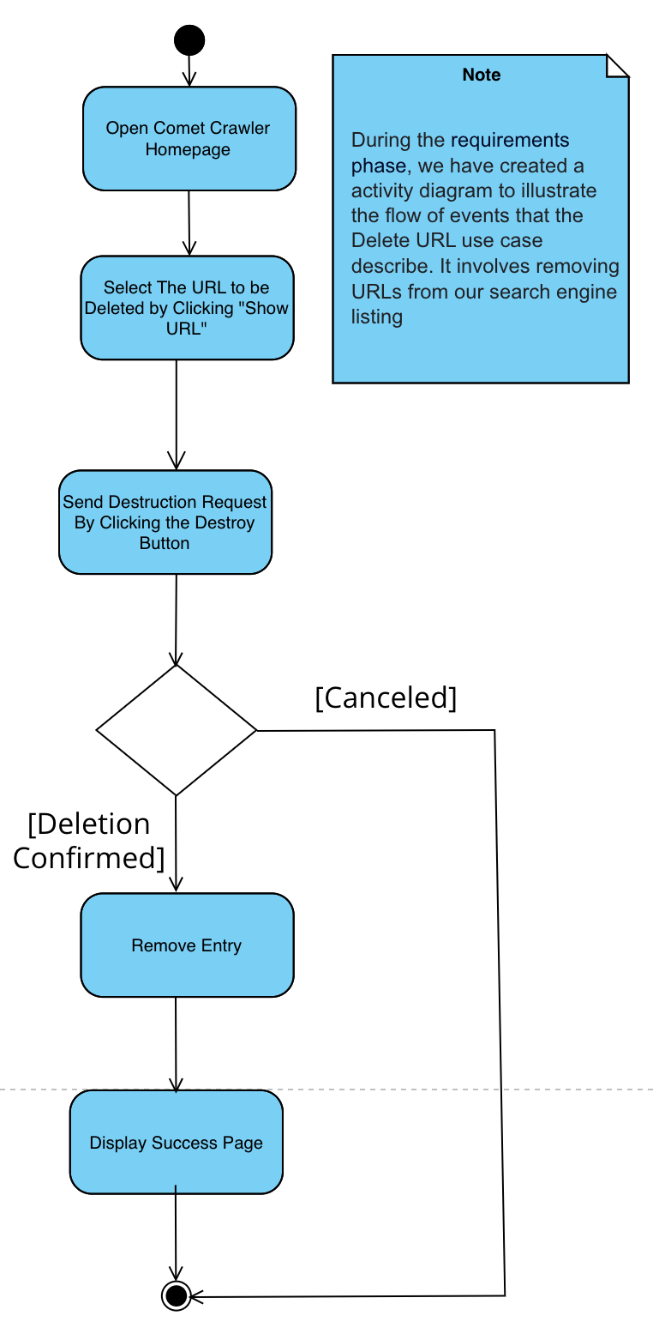
Activity Diagrams
Add URL Activity Diagram
Delete URL Activity Diagram

Slide 19
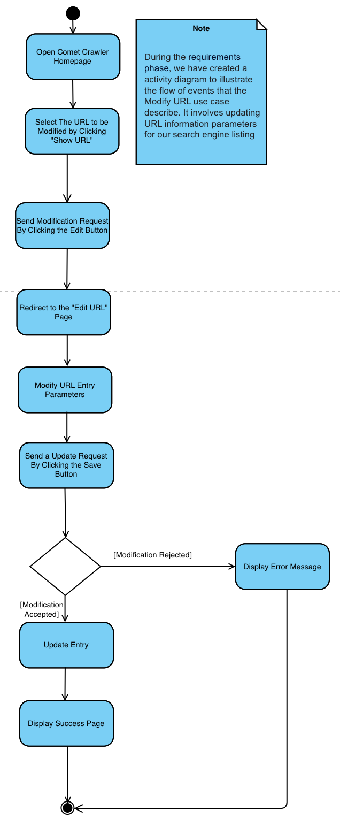
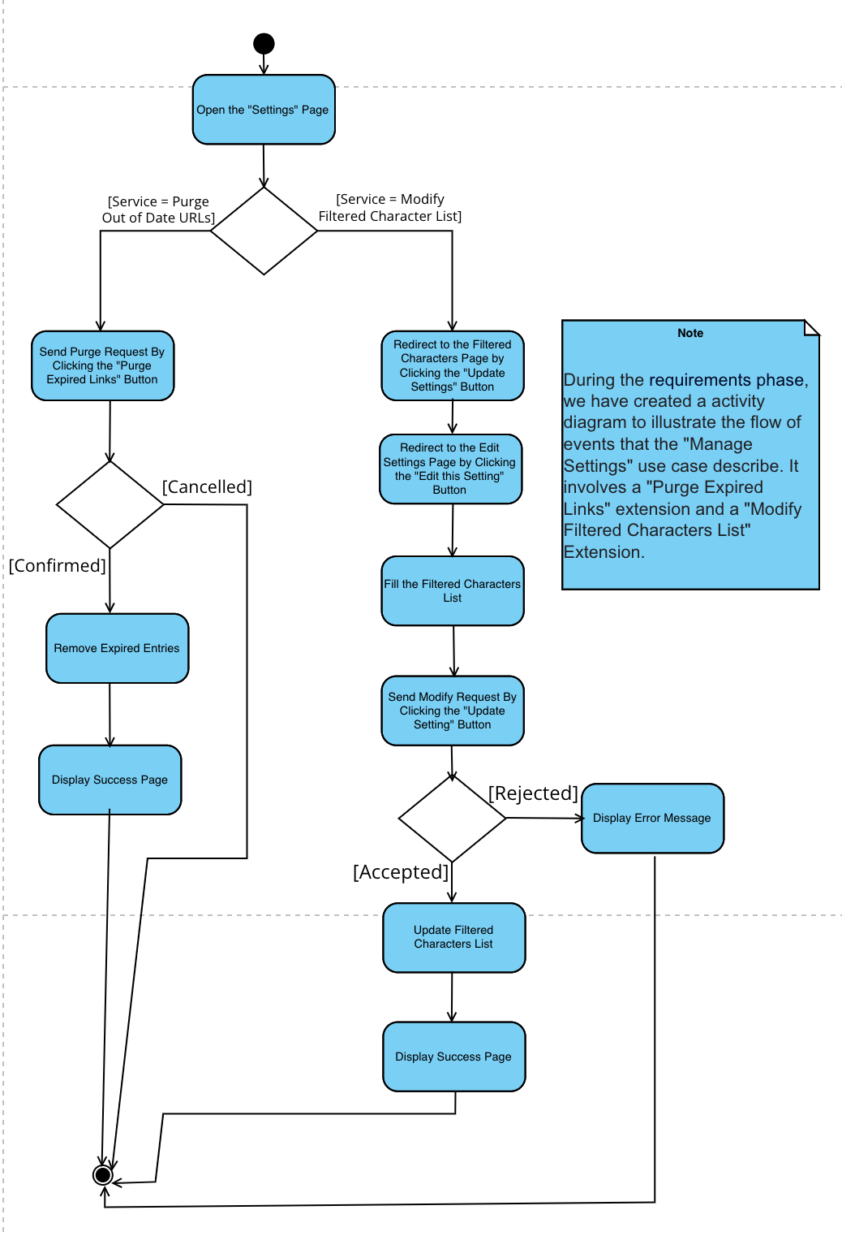
Activity Diagrams
Modify URL Activity Diagram
Manage Settings Activity Diagram

Slide 20
System Sequence Diagrams
This diagram is a part of Requirements

Slide 21
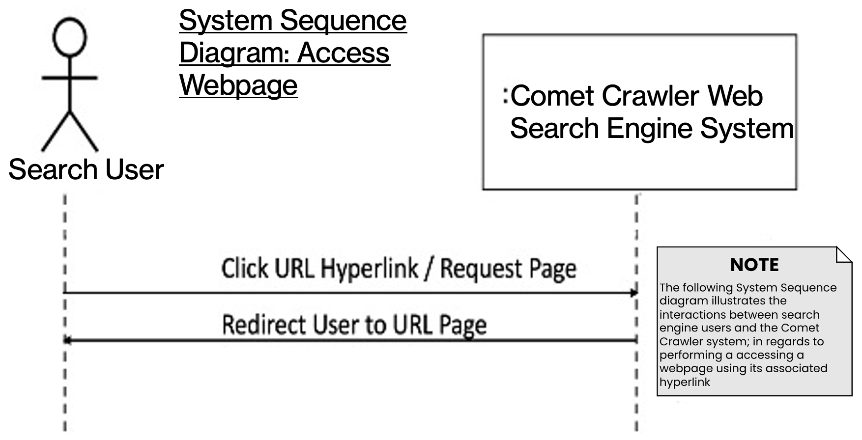
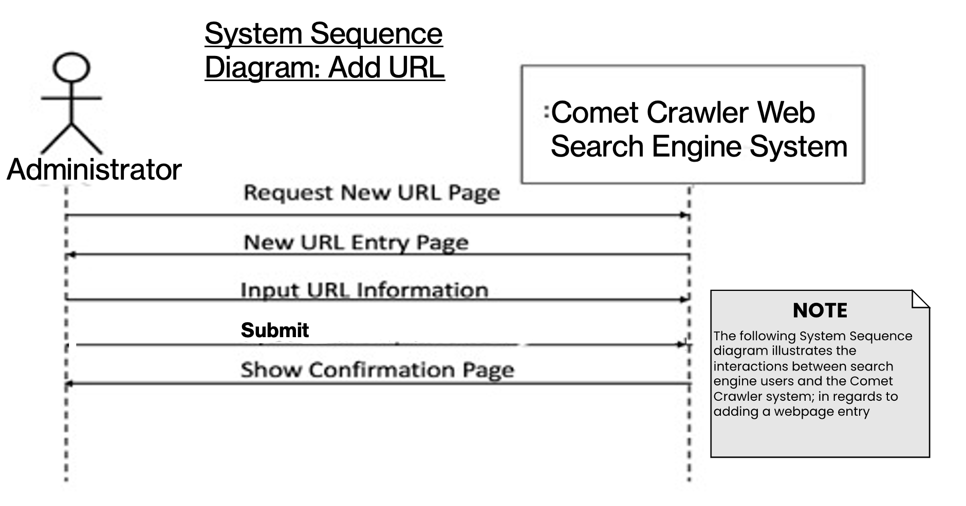
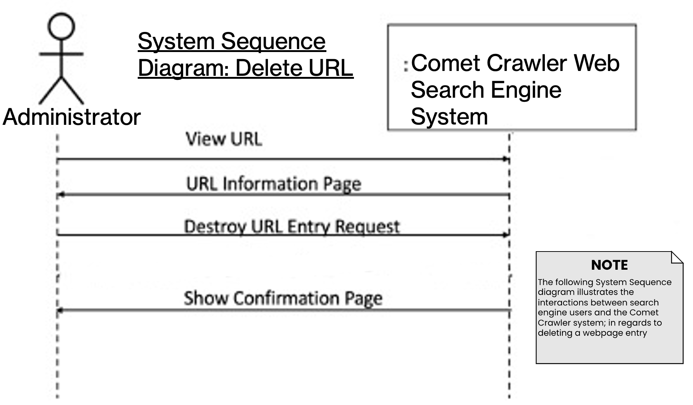
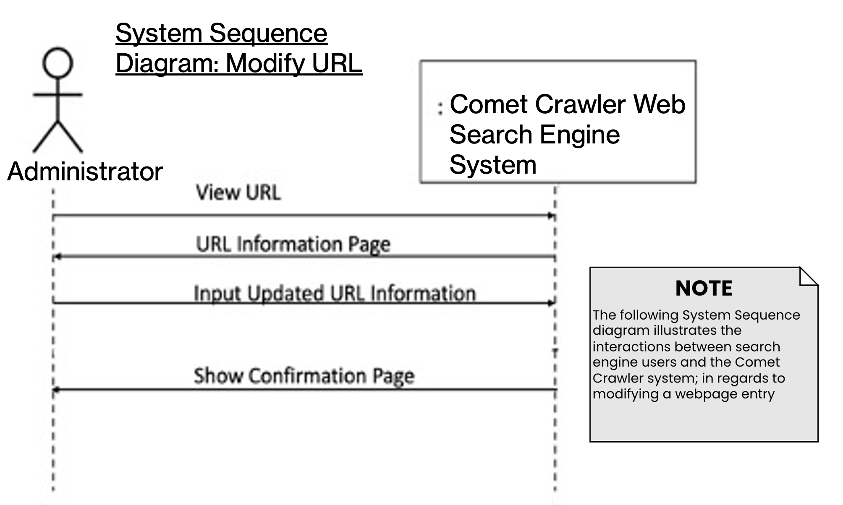
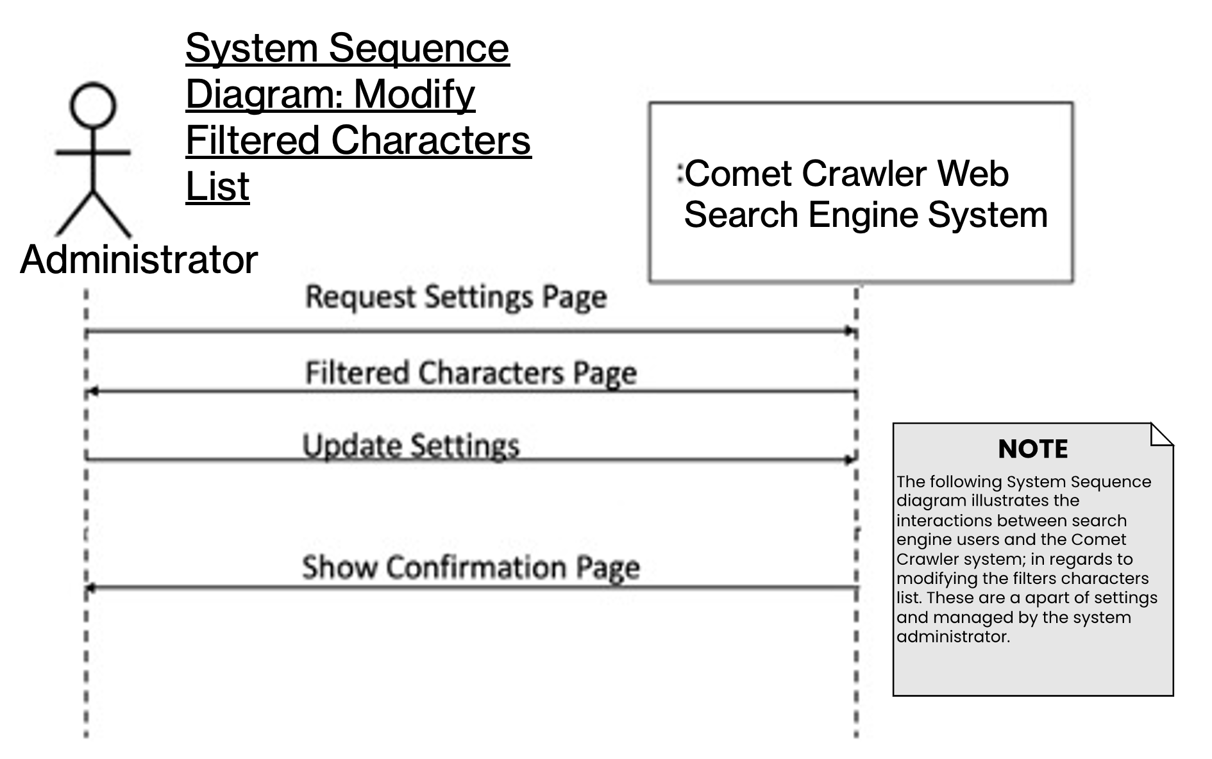
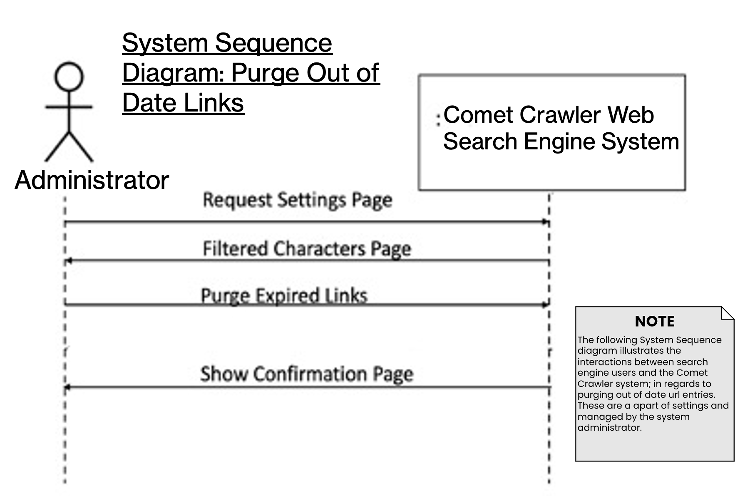
System Sequence Diagrams
These diagrams are a part of Requirements

Slide 22
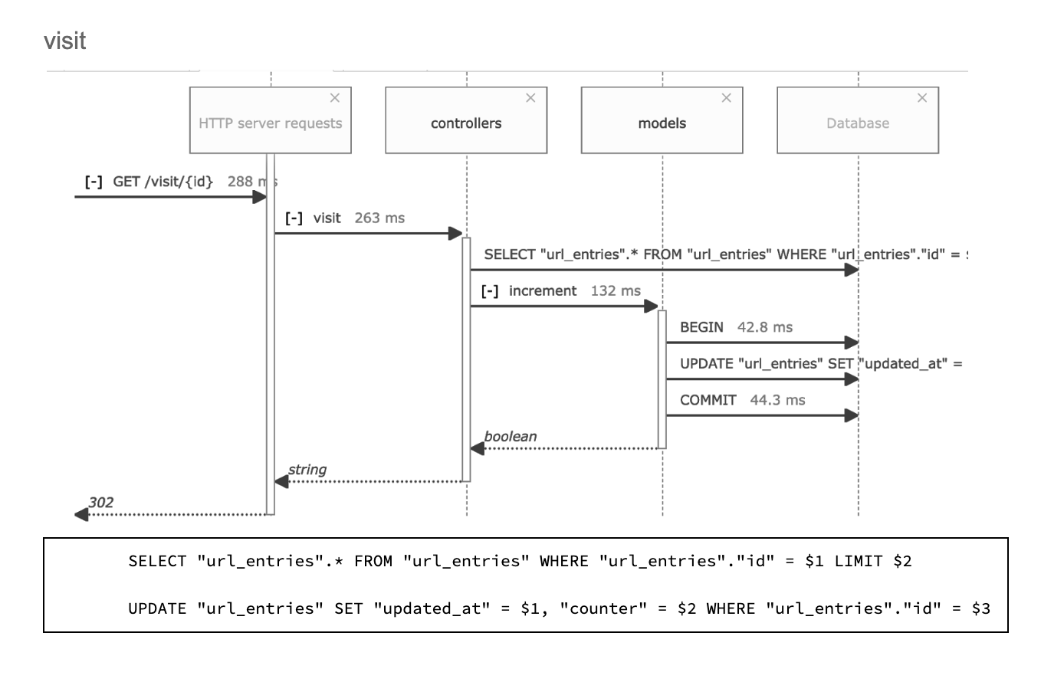
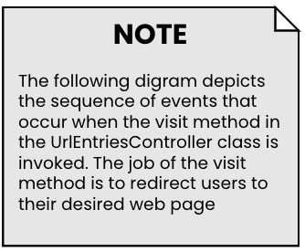
Design Sequence Diagram: Request and Response
UrlEntriesController
This diagram is a part of Design

Slide 23
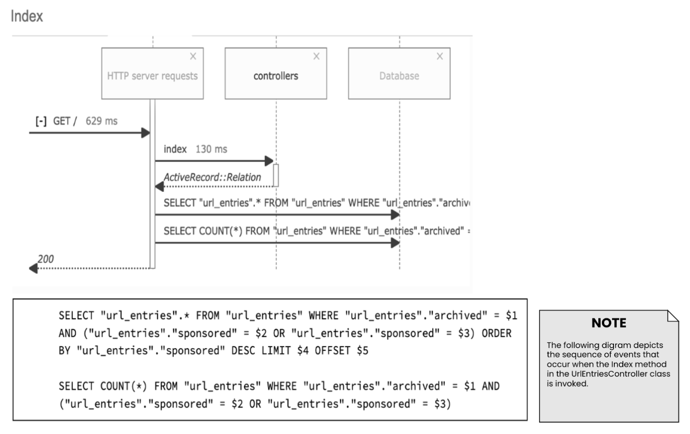
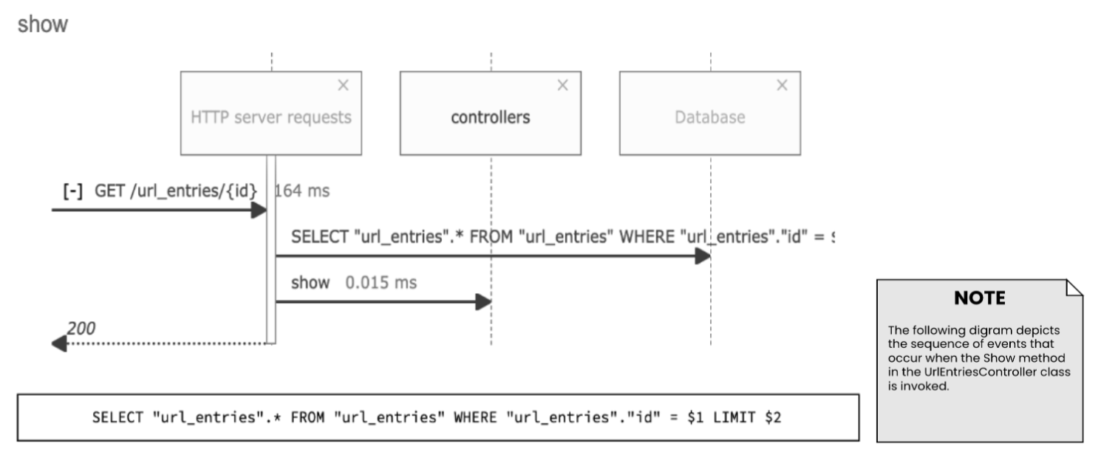
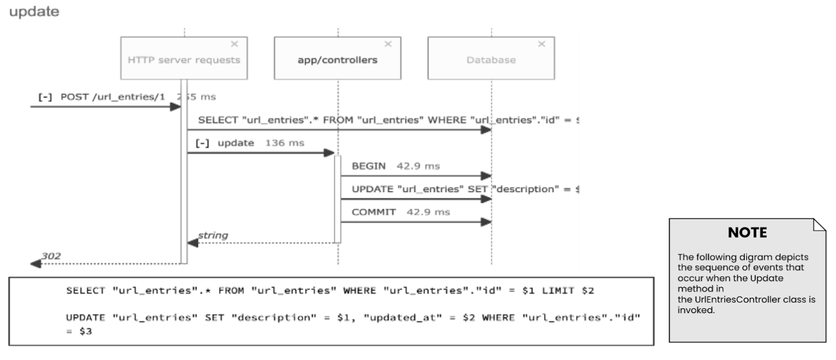
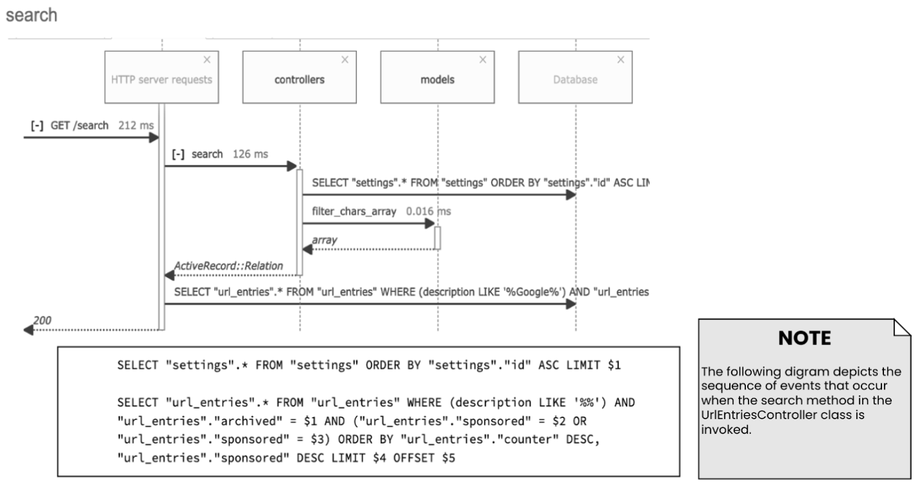
Design Sequence Diagrams
These diagrams are a part of Design
UrlEntriesController
UrlEntriesController
UrlEntriesController
UrlEntriesController

Slide 24
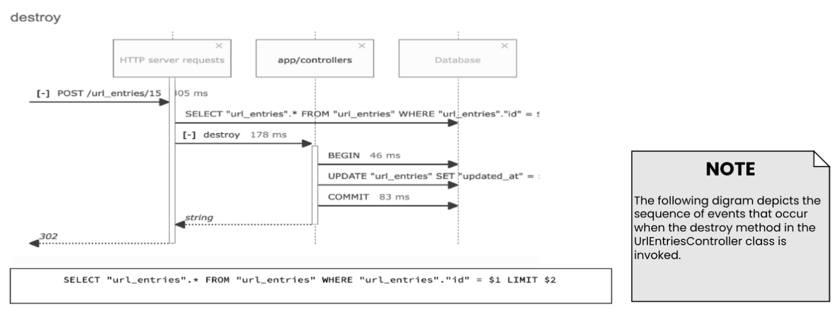
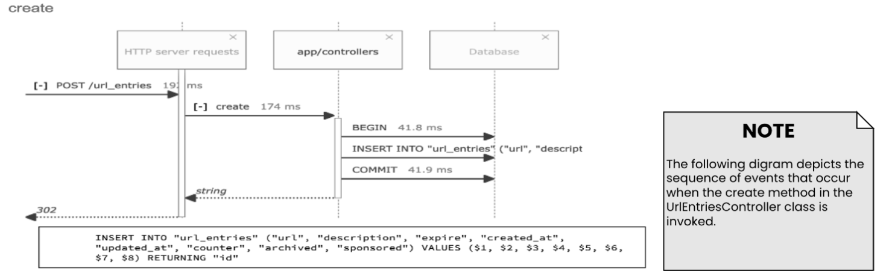




Design Sequence Diagrams
These diagrams are a part of Design
UrlEntriesController
UrlEntriesController
SettingController
SettingController
SettingController
SettingController

Slide 25

Design Class Diagram
This diagram is a part of Design

Slide 26


State Transition Diagram for User Services
State Transition Diagram for Administrator Services
State Transition Diagrams

Slide 27

Demo

